Slide 1
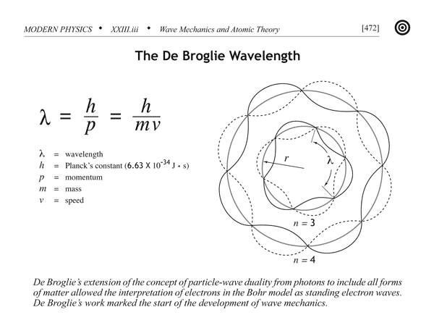
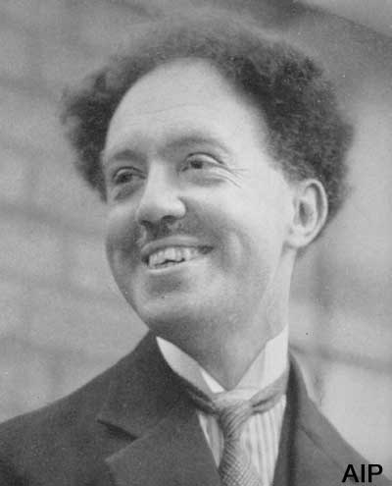
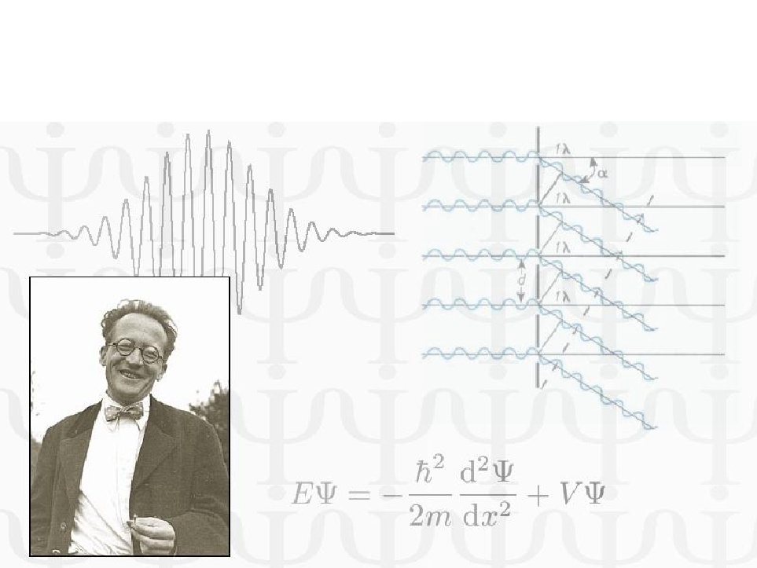
Unit-II: QUANTUM MECHANICS
By
Dr. Abhishek Kumar Gupta
Assistant Professor
Physics and Material Science Department
Email- akgpms@mmmut.ac.in
Cont. No- 8765783678

Slide 2
de Broglie Matter-Waves and Wave–Particle Duality
Wave character
Particle character
WAVE–PARTICLE DUALITY

Slide 3
Nature of a wave
A wave is described by frequency (ν), wavelength (λ), phase velocity (u) and intensity (I)
A wave is spread out and occupies a relatively large region of space

Slide 4
Nature of a particle
A particle is specified by mass (m), velocity (v), momentum (p), and energy (E).
A particle occupies a definite position in space.

Slide 5
Light
Interference and Diffraction experiments showed the wave nature of light
Blackbody radiation and Photoelectric effect can be explained only by considering light as a stream of particles

Slide 6
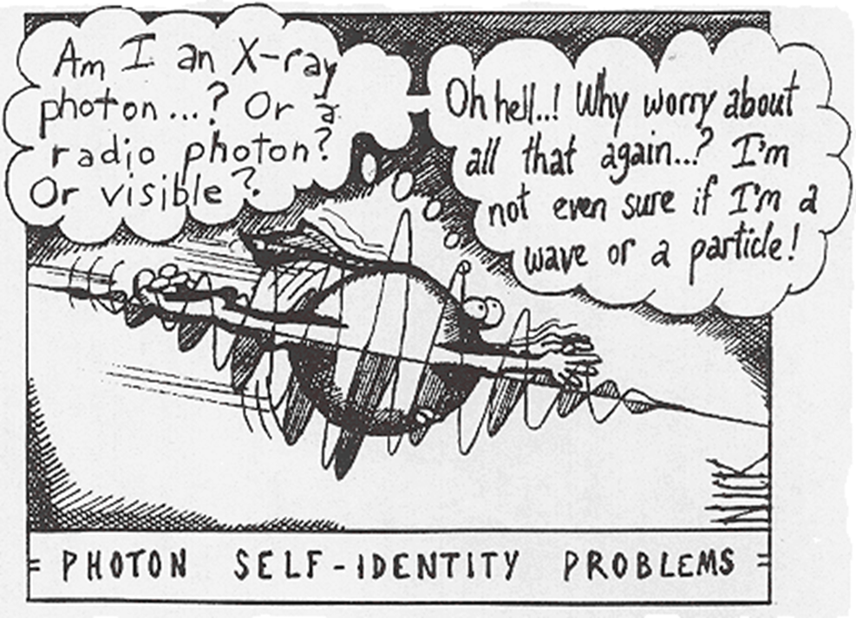
So, Is light a wave or a particle ?

Slide 7
WAVE–PARTICLE DUALITY
concept of a particle
Mass: A particle must have definite mass.
Velocity: A particle can move from one place to another with a certain velocity.
Position: A particle may be located at some definite place or point.
Momentum: A particle having mass and velocity possesses momentum during its motion.
Energy: A particle has energy in different forms in different situations such as potential energy, kinetic energy, rest-mass energy.

Slide 8
WAVE–PARTICLE DUALITY
concept of a wave
Lack of position: A wave is always realised as a disturbance; it is spread out over a relatively large region of space. It cannot be located at some definite place or point.
Mass: It is very difficult to think about the mass being associated with a wave.
Frequency and wavelength: A wave or disturbance, which advances in a medium, has a certain frequency and wavelength.
Phase of wave velocity: Phase gives an idea about the instantaneous position and direction of a wave.
Amplitude: The amplitude of a wave gives an idea of the intensity of disturbance in the medium.

Slide 9
DE BROGLIE HYPOTHESIS
In the Year 1924 Louis de Broglie made the bold suggestion
If light can act like a wave sometimes and like a particle at other times, then all matter, usually thought of as particles, should exhibit wave-like behaviour
The relation between the momentum and the wavelength of a photon can be applied to material particles also

Slide 10
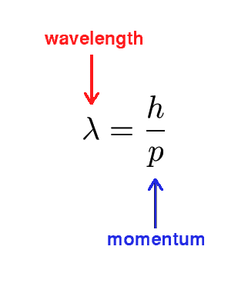
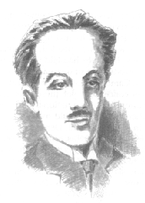
De- Broglie Wavelength
Relates a particle-like property (p) to a wave-like property (l)

Slide 11
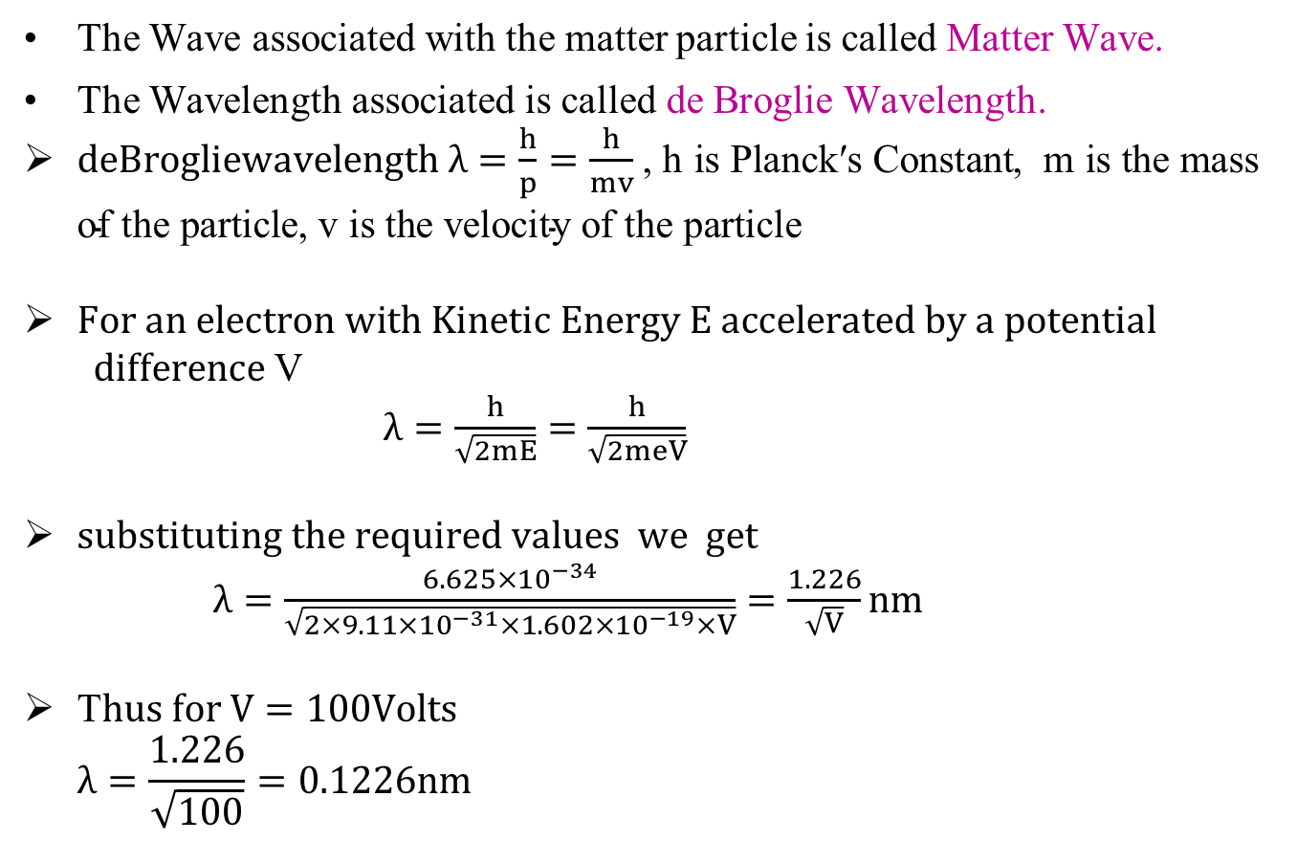
DE BROGLIE WAVELENGTH
The Wave associated with the matter particle is called Matter Wave.
The Wavelength associated is called de Broglie Wavelength.
$deBrogliewavelength λ=\frac{h}{p}=\frac{h}{mv}$ , $\text{h} \text{is} \text{Planck}\text{′}\text{s} \text{Constant}$, $\text{m} \text{is} \text{the} \text{mass} \text{of} \text{the} \text{particle}$, $\text{v} \text{is} \text{the} \text{velocity} \text{of} \text{the} \text{particle}$
$For an electron with Kinetic Energy E accelerated by a potential$
$difference$V $λ=\frac{h}{\sqrt{2mE}}=\frac{h}{\sqrt{2meV}}$
$substituting the required values we get$
$λ=\frac{6.625×10^{−34}}{\sqrt{2×9.11×10^{−31}×1.602×10^{−19}×V}}=\frac{1.226}{\sqrt{V}}nm$
T$hus for V=100Volts$ $λ=\frac{1.226}{\sqrt{100}}=0.1226nm$

Slide 12


The Frequency
De Broglie postulated that all particles satisfy Einstein’s relation
E = h$ν$
In other words,
$$ν=\frac{E}{h}$$

Slide 13
de BROGLIE HYPOTHESIS OF MATTER-WAVES
According to this theory, light may be considered as a stream of photons (particles) having mass (hν/c²), energy (hν), velocity (c), and momentum (hν /c).
However, this theory (photon/Quantum theory) could not explain the phenomena like interference, diffraction, and polarisation.
It indicates that the various phenomena of light (radiation) can be made only on the basis of the dual nature of light (radiation).
Thus, light has dual nature, i.e., it possesses both particle and wave nature. It is important to remember that wave and particle nature can never appear together.

Slide 14

de BROGLIE HYPOTHESIS OF MATTER-WAVES
Extending the idea of wave–particle duality of radiation (light), Louis de Broglie in 1924 suggested that this duality is true not only for radiation but it is also true for all the moving material particles of the universe.
It means that like radiation, matter also have wave–particle duality. The wavelength of the matter-wave is given by

Slide 15
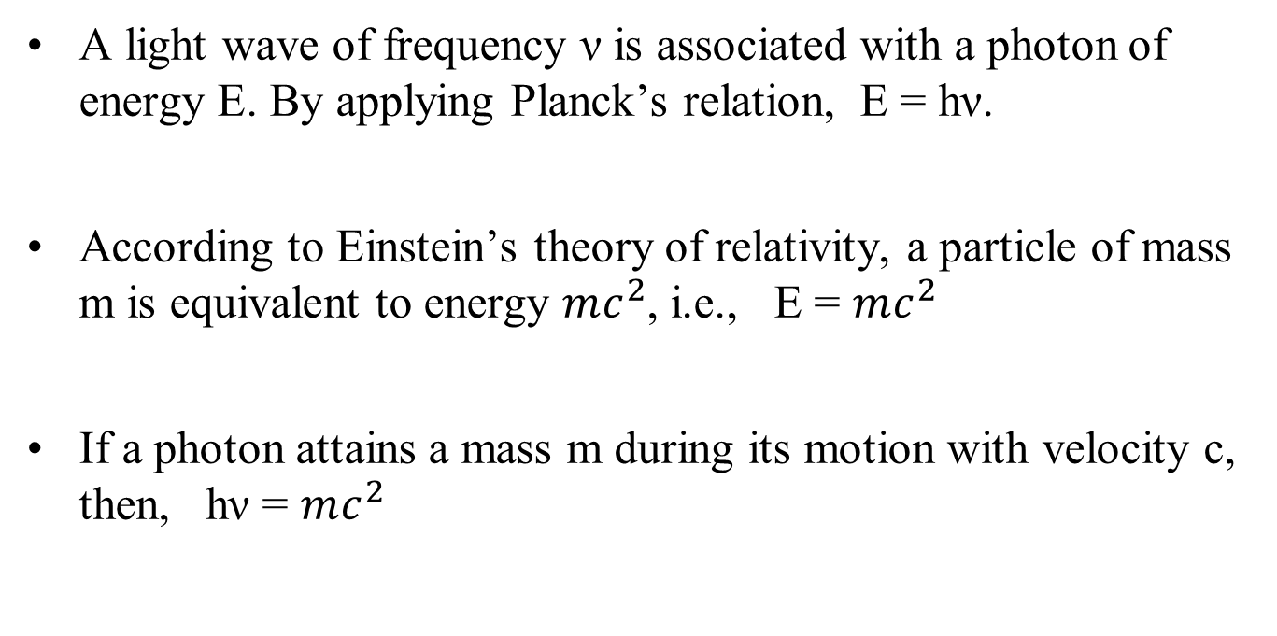
EXPRESSION FOR WAVELENGTH OF MATTER-WAVE (de BROGLIE WAVELENGTH)
A light wave of frequency ν is associated with a photon of energy E. By applying Planck’s relation, E = hν.
According to Einstein’s theory of relativity, a particle of mass m is equivalent to energy $mc^{2}$, i.e., E = $mc^{2}$
If a photon attains a mass m during its motion with velocity c, then, hν = $mc^{2}$

Slide 16

EXPRESSION FOR WAVELENGTH OF MATTER-WAVE
Since the momentum of photon is p = mc, using this relation in above equation, hν = pc
= pνλ (because c = νλ)

Slide 17
Example: de Broglie wavelength of an electron
Mass = 9.11 x 10⁻³¹ kg Speed = 10⁶ m / sec
This wavelength is in the region of X-rays

Slide 18
Example: de Broglie wavelength of a ball
Mass = 1 kg Speed = 1 m / sec

Slide 19
PROPERTIES OF MATTER-WAVES
The lighter particles have greater wavelength than the heavier particles.
The smaller the velocity of the particle, the greater is the wavelength λ=h/mv associated with it.
From the expression of the de Broglie wavelength, i.e., λ = (h/mv, if v = 0, then λ = ∞, whereas if v = ∞, then λ = 0. This shows that the matter-waves are generated only when the particle is in motion.

Slide 20
PROPERTIES OF MATTER-WAVES
The matter-waves are independent of the charge. Thus, they are produced by both charged and uncharged particles. This shows that the matter-waves are not electromagnetic waves; they are entirely different waves.
The velocity of the matter-waves is not constant. It depends on the velocity of the particle, while the velocity of the electromagnetic waves is constant.
The velocity of the matter-waves may be greater than the velocity of light.

Slide 21

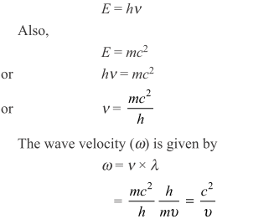
PROPERTIES OF MATTER-WAVES Contd..
Wave velocity of a matter-wave is given in terms of group velocity as
Since a particle cannot travel with the velocity more than the velocity of light, thus, w will be greater than the velocity of light. The satisfactory explanation of such unexpected result can be explained with the help of wave velocity and group velocity.

Slide 22
PROPERTIES OF MATTER-WAVES
where u _{group} is equal to the particle velocity (see Section 22.15). Since a particle cannot travel with the velocity more than the velocity of light, the velocity of matter-wave will be greater than c.
Wave–particle duality (wave nature of matter) introduces the concept of uncertainty. This concept suggests that if the particle nature of matter becomes certain, the wave nature will be uncertain and vice versa.

Slide 23

de WAVE VELOCITY OR PHASE VELOCITY
The velocity of advancement of a monochromatic wave (i.e., a wave of single frequency and wavelength) in a medium is known as wave velocity, or phase velocity.
The velocity of propagation of planes of constant phase through a medium is known as wave velocity, or phase velocity.

Slide 24
NEED FOR WAVE PACKET REPRESENTATION
For the material particle (including electron and proton), u is always less than c.
It means that, according to v=c²/u, the phase velocity of the wave associated with the material particle is always greater than c.
Now, it can be concluded that the particle and its corresponding de Broglie wave cannot travel together.
Hence, the particle should be left behind to its de Broglie wave.

Slide 25
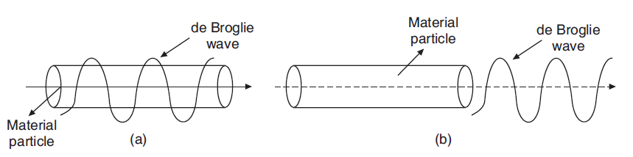
NEED FOR WAVE PACKET REPRESENTATION

Slide 26
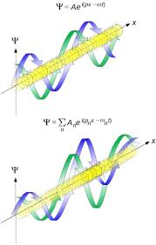
NEED FOR WAVE PACKET REPRESENTATION
From the earlier discussion, it seems that the particle will not be able to keep pace with the associated de Broglie wave.
However, it is not so. In order to explain the conflicting idea of velocity relationship between material particle and its de Broglie wave, Schrödinger himself introduced the idea of wave packet.
According to the idea of wave packet, a moving material particle is equivalent to a wave packet (number of waves) instead of a single wave.

Slide 27
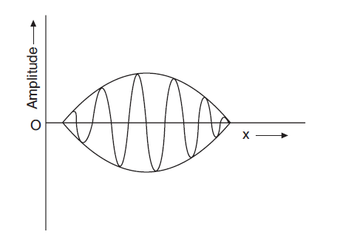
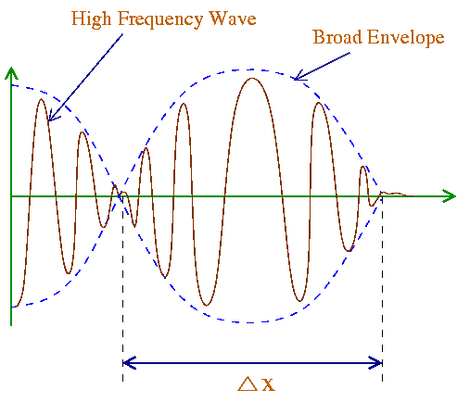
Wave Packet
A wave packet is the resultant of a group of waves, slightly differing in velocity and wavelength, with such phase and amplitude that they interfere constructively over a small region of space where the particle can be located.
Outside this space, they interfere destructively so that the amplitude reduces to zero.

Slide 28
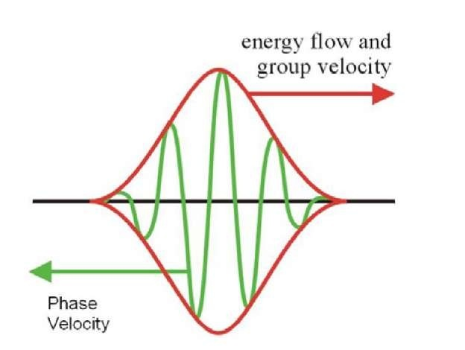

GROUP VELOCITY
The velocity with which a wave packet (or the group of waves) associated with the moving particle travels is called the group velocity, whereas the velocity with which the individual waves comprising the wave packet travel is referred to as wave velocity, or phase velocity.

Slide 29

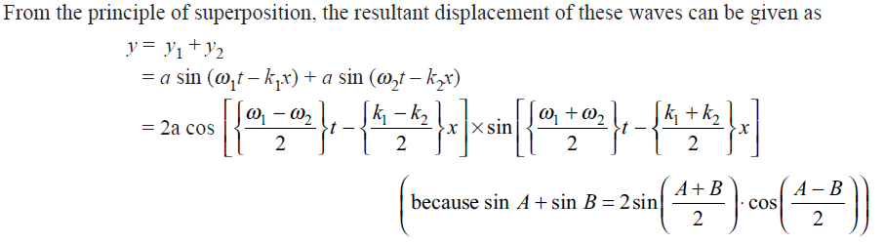
EXPRESSION FOR GROUP VELOCITY

Slide 30
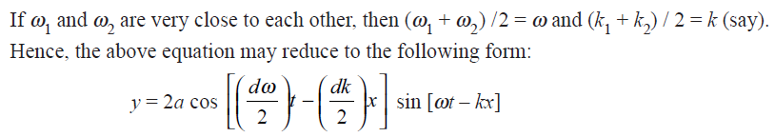


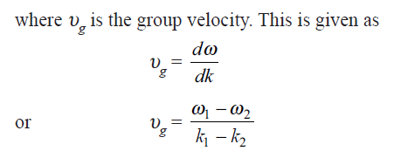
EXPRESSION FOR GROUP VELOCITY

Slide 31
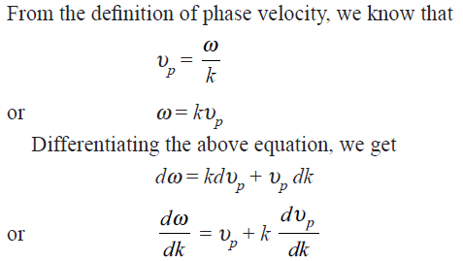
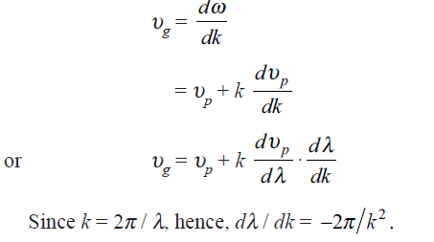

RELATION BETWEEN GROUP VELOCITY AND WAVE VELOCITY

Slide 32
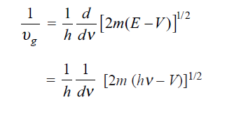
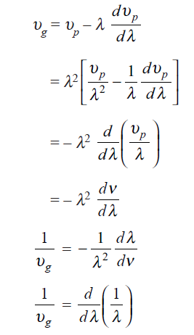
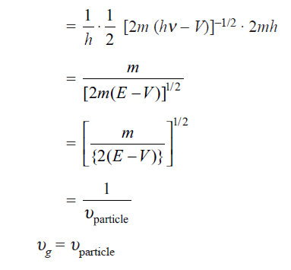

RELATION BETWEEN GROUP VELOCITY AND PARTICLE VELOCITY

Slide 33
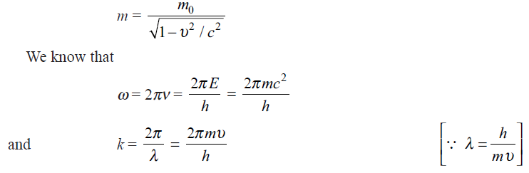
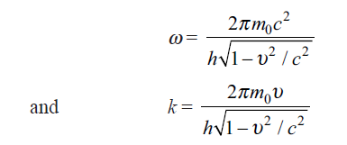
GROUP VELOCITY OF de BROGLIE WAVES
According to the relativistic consideration

Slide 34


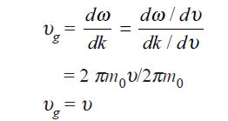
GROUP VELOCITY OF de BROGLIE WAVES
Differentiating ω and k with respect to v

Slide 35
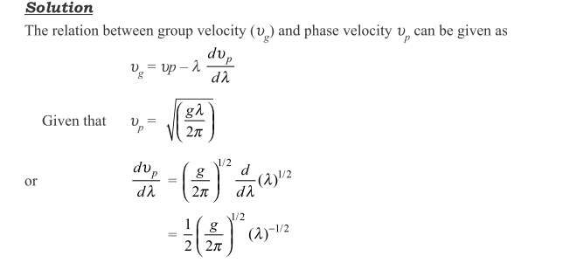
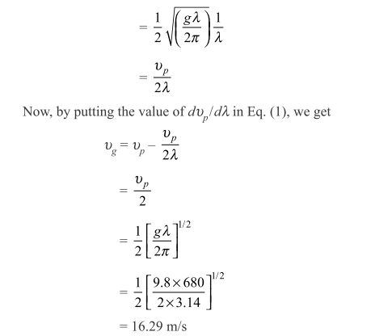

Slide 36
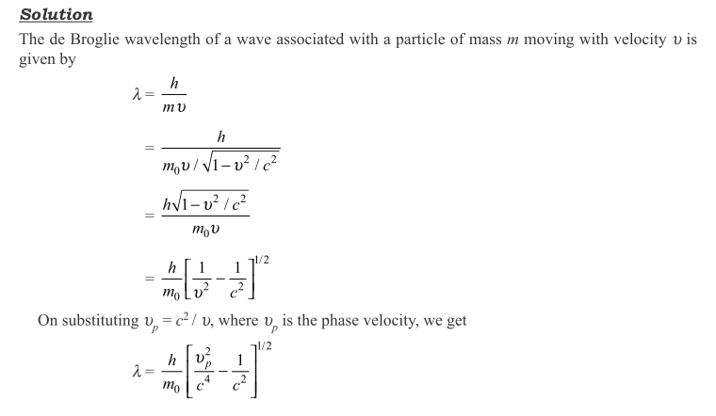
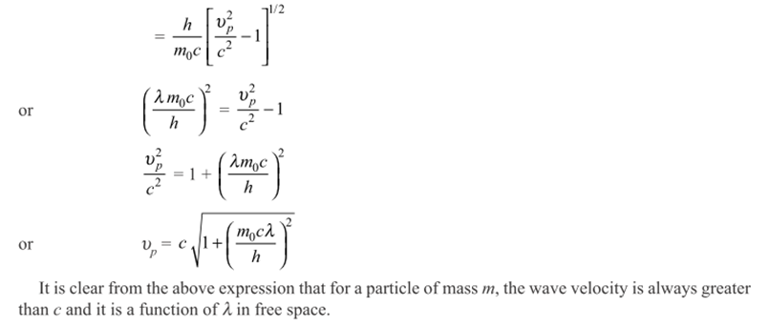
Example
Show that the de Broglie wave velocity is a function of wavelength even in free space.

Slide 37
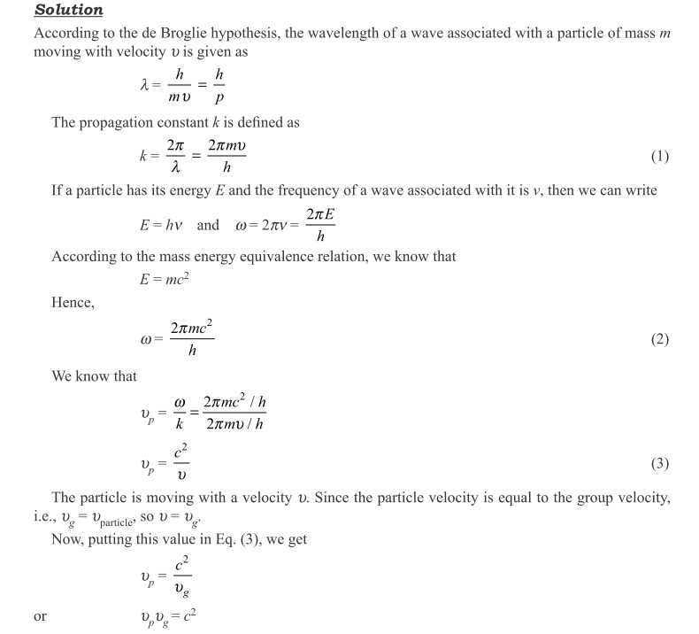

Slide 38
de BASIS FOR UNCERTAINTY PRINCIPLE
Although in the beginning scientists were reluctant to accept this principle, but the strong evidences forced them to accept the uncertainty principle.

Slide 39
BASIS FOR UNCERTAINTY PRINCIPLE
The material particle exhibits particle nature as well as exhibits wave nature, but it does not simultaneously possess both the natures.
Instead of being contradictory, the wave and particle natures are complementary.
Bohr’s principle of complementarity is the consequence of de Broglie hypothesis.
Under the de Broglie hypothesis, particles may be represented as wave packets. The particle may be anywhere inside the wave packet. Hence, there will be uncertainty in the measurement of position of the particle.

Slide 40
HEISENBERG’S UNCERTAINTY PRINCIPLE
The Heisenberg’s uncertainty principle states that it is not possible to simultaneously measure the position and the momentum of a particle to any desired degree of accuracy.
In other words, the product of uncertainty in the measurement of position (∆x) and uncertainty in the measurement of momentum (∆p) is always constant, and it is at least equal to Planck’s constant (h), i.e.,
∆p ⋅ ∆x = h
Similar to above expression, we can write
∆E ⋅ ∆t = h
and ∆J ⋅ ∆ѳ = h
where ∆E and ∆t are the uncertainties in determining energy and time, respectively. Similarly, ∆J and ∆ѳ are the uncertainties in the measurement of angular momentum and angle, respectively.

Slide 41
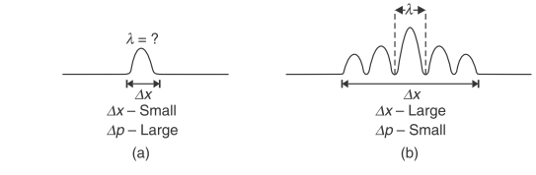
Explanation
To understand the uncertainty in the measurement of position and momentum of microscopic particles, let us take the examples of narrow and wide wave packets.
In a narrow wave packet [Fig.(a)], the position of the particle can be precisely determined, but not the wavelength.
As a result, the particle’s momentum cannot be measured accurately as there are not enough waves to exactly measure the wavelength (λ = h/mv).
On the other hand, in a wider wave packet [Fig.(b)], the wavelength can be determined exactly but the position of the particle will be uncertain due to the large width of the wave packet.
Hence, it can be concluded that it is impossible to simultaneously determine the exact position and the exact momentum of a particle.

Slide 42


DERIVATION OF UNCERTAINTY PRINCIPLE
In order to derive uncertainty principle let us consider two simple harmonic plane waves of same amplitude A having nearly equal frequencies w₁ and w₂ with propagation vectors k₁ and k₂, respectively.
Using the principle of superposition the resultant equation can be given as

Slide 43



DERIVATION OF UNCERTAINTY PRINCIPLE
The resultant of these equations can be given as the wave packet given below
In wave packets, the position of the particle remains uncertain between successive nodes

Slide 44
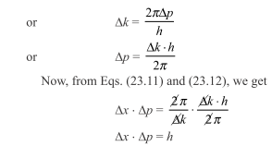
DERIVATION OF UNCERTAINTY PRINCIPLE

Slide 45
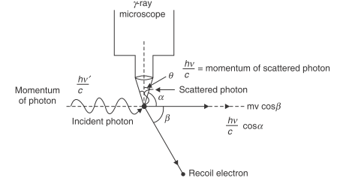
EXPERIMENTAL EXAMPLES OF UNCERTAINTY PRINCIPLE
Determination of the Position of a Particle by γ-ray Microscope
To measure the exact position and the momentum of an electron along the X-axis in the field of view of an ideally high resolving power microscope, let us consider a photon being incident on an electron in the field of view of microscope as shown in Fig.

Slide 46

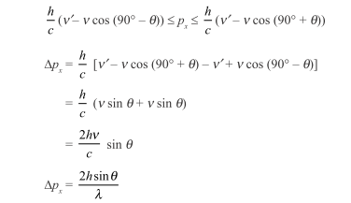
EXPERIMENTAL EXAMPLES OF UNCERTAINTY PRINCIPLE
The resolving power of a microscope can be given as
and
Combining above expressions of ∆p and ∆x we get

Slide 47

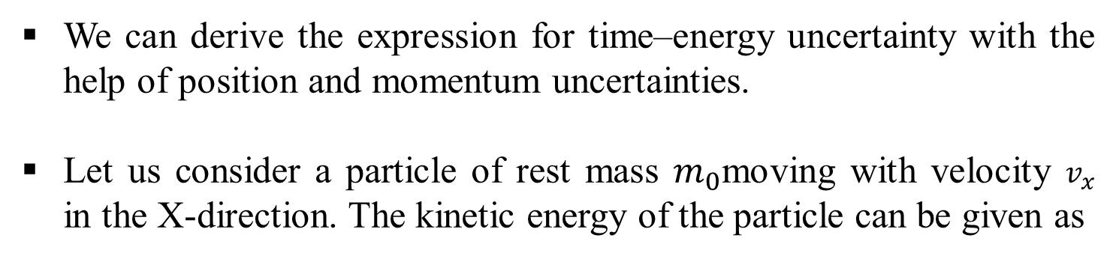
TIME–ENERGY UNCERTAINTY PRINCIPLE
We can derive the expression for time–energy uncertainty with the help of position and momentum uncertainties.
Let us consider a particle of rest mass $m_{0}$moving with velocity $v_{x}$ in the X-direction. The kinetic energy of the particle can be given as

Slide 48
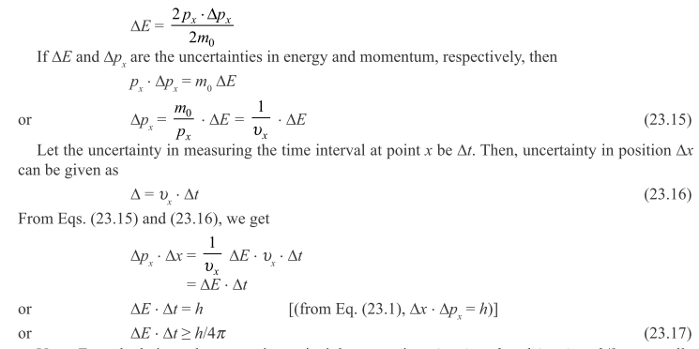
TIME–ENERGY UNCERTAINTY PRINCIPLE

Slide 49
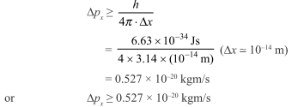
Applications of Uncertainty Principle
1. Non-Existence of Electrons in the Nucleus
Since the diameter of nucleus is of the order of 10 ^{–14} m, the maximum uncertainty in the measurement of position of the electron in the nucleus will be of the order of ∆x = 10 ^{–14} m.
Using Heisenberg’s uncertainty relation, the uncertainty in the measurement of moment of the electron is given as

Slide 50
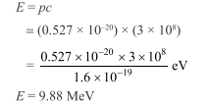
Applications of Uncertainty Principle
The above calculation shows that an electron can exist in the nucleus if its energy is of the order of 9.88 MeV.
But we know that the electrons emitted by radioactive nuclei during β-decay have energies of the order of 3 MeV to 4 MeV only.
Hence, electrons cannot exist in the nucleus.

Slide 51
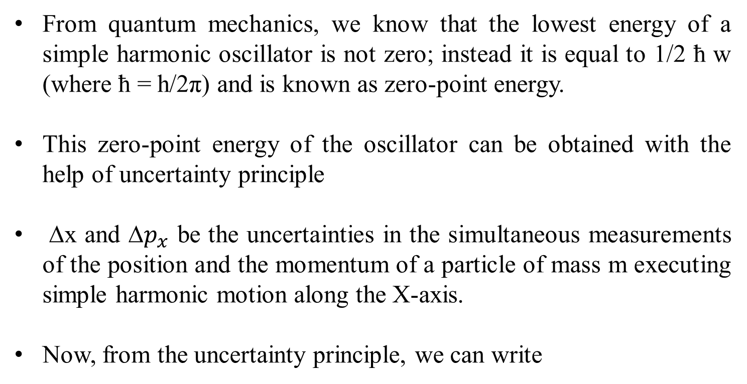
Zero-Point Energy of a Harmonic Oscillator
From quantum mechanics, we know that the lowest energy of a simple harmonic oscillator is not zero; instead it is equal to 1/2 ħ w (where ħ = h/2π) and is known as zero-point energy.
This zero-point energy of the oscillator can be obtained with the help of uncertainty principle
∆x and ∆$p_{x}$ be the uncertainties in the simultaneous measurements of the position and the momentum of a particle of mass m executing simple harmonic motion along the X-axis.
Now, from the uncertainty principle, we can write

Slide 52
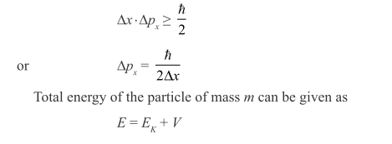
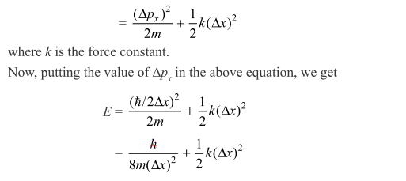

Slide 53
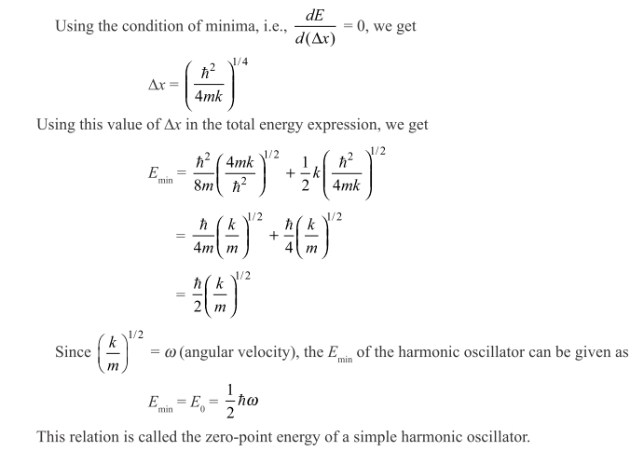

Slide 54
APPLICATIONS OF UNCERTAINTY PRINCIPLE CONTD…
Some other applications of uncertainty principle can be given as
Existence of Protons, Neutrons, and α-particles in the Nucleus can be proved with the use of uncertainty principle.
Binding Energy of an Electron in an Atom can be calculated with help of uncertainty principle
Radiation of Light emitted from an Excited Atom can be calculated with help of uncertainty principle

Slide 55
Consequences of Uncertainty Principle
The most important consequence of uncertainty principle is the dual nature of matter.
In the dual nature, it is not possible to determine the wave and particle properties exactly at the same time.
The complementarity principle states that the wave and particle aspects of matter are complementary, instead of being contradictory.
This principle suggests that the consideration of particle and light natures is necessary to have a complete picture of the same system.

Slide 56
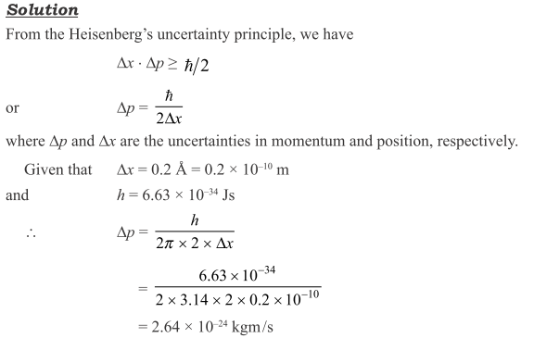
Example-1
An electron microscope is used to locate an electron in an atom within a distance of 0.2 Å. What is the uncertainty in the momentum of the electron located in this way?

Slide 57
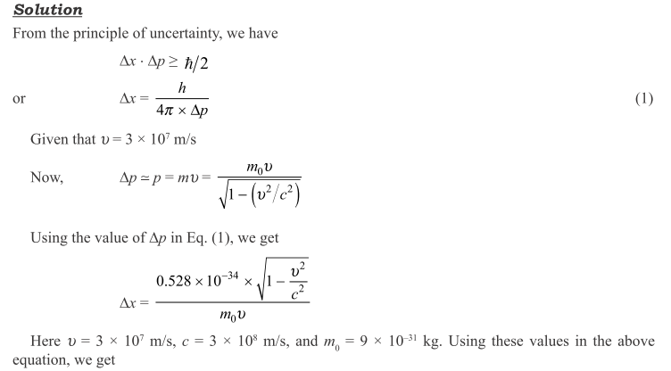
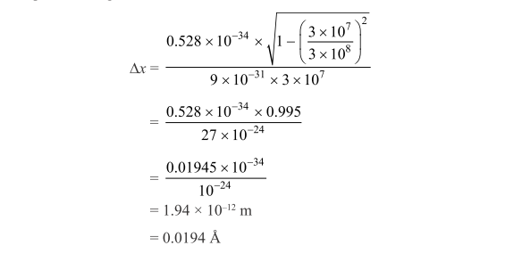
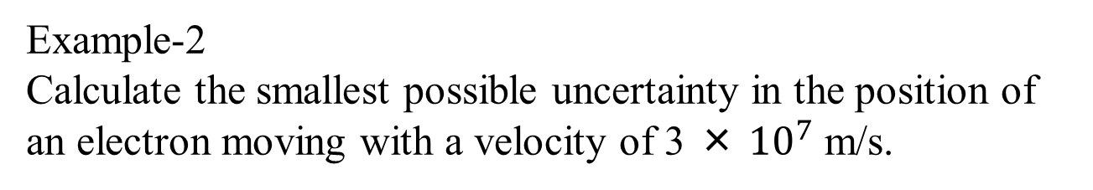
Example-2
Calculate the smallest possible uncertainty in the position of an electron moving with a velocity of 3 × ${10}^{7}$ m/s.

Slide 58
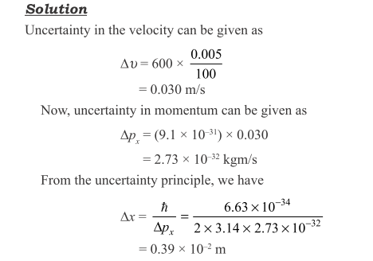
Example-3
An electron has the velocity of 600 m/s with an accuracy of 0.005%. Calculate the uncertainty with which we can locate the position of the electron.

Slide 59
Assignment Based on this Lecture
Define phase velocity and obtain the expression for phase velocity.
Discuss the need for wave packet representation.
Define group velocity and obtain the expression for group velocity.
Obtain the relation between phase velocity and group velocity
Prove that the particle always travel with group velocity.

Slide 60
Assignment Based on this Lecture continue..
Describe the basis of uncertainty principle.
Heisenberg uncertainty principle.
Obtain the expression of uncertainty principle for position and momentum.
Discuss experimental examples of uncertainty principle
Explain the consequences of Uncertainty principle.
Proof of Non existence of electron in the nucleus.
Other applications of Uncertainty Principle.

Slide 61
de NATURE OF ELECTRON
Before 1924, the electron was exclusively regarded as a particle but after the suggestion of de Broglie, the electron was given the wave–particle duality.
There are many experimental evidences which prove that the electron is a particle, as it has a definite mass, charge, energy, and momentum.
Additionally, the impact of the electron on the screen of zinc sulphide proves its identity as a particle.

Slide 62
NATURE OF ELECTRON
There are some experimental evidences which prove that the electron has a wave nature as well, i.e., a wave is associated with the electron during its motion. The following are
Some experiments which support the wave nature of electrons:
Davisson and Germer diffraction experiment
G.P. Thomson experiment

Slide 63
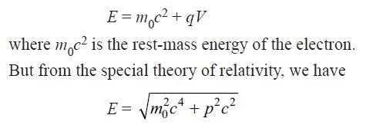
DAVISSON AND GERMER EXPERIMENT FOR MATTER-WAVES
Principle: If an electron is accelerated through a potential difference of V volts, then the electron acquires the kinetic energy equivalent to qV joule, where q is the charge on the electron (in coulomb). The total energy E of the electron becomes :

Slide 64

DAVISSON AND GERMER EXPERIMENT FOR MATTER-WAVES

Slide 65


DAVISSON AND GERMER EXPERIMENT FOR MATTER-WAVES
With above expressions de Broglie hypothesis gives us

Slide 66

EXPERIMENTAL SET UP

Slide 67

Results and discussion:
The experimental results are discussed on the basis of different curves obtained between scattering angle ф and the intensity of scattered beam of electrons, corresponding to different accelerating voltages V. It is observed that intensity is maximum at 54 volt corresponding to the scattering angle of 50⁰ .

Slide 68

Bragg’s atomic planes
In order to test the theoretical result experimentally we use Bragg’s law

Slide 69
DAVISSON AND GERMER EXPERIMENT
Using Bragg’s law we get ѳ= 65⁰ . Interatomic spacing d=0.91 A⁰
If λ is the wavelength of the de Broglie wave associated with the electron, then according to Bragg’s law, we can write
2d sin θ= nλ
where d is the inter-atomic spacing and n is the order of diffraction. For the nickel crystal d = 0.91 Å,
For first-order (n = 1) diffraction maxima,
λ = 2 × 0.91 Å × sin 65°= 1.65 Å

Slide 70

DAVISSON AND GERMER EXPERIMENT
de Broglie wavelength can also be calculated from Eq. (22.11), for V = 54 V as given below:
λ= $\frac{12.27}{\sqrt{54}} =$ = 1.67 Å
This value of wavelength is very close to the experimentally obtained value of λ.
Hence, it can be concluded that a wave is associated with a particle during its motion.
Thus the de Broglie hypothesis of matter-waves is experimentally proved.

Slide 71

Example-1
Calculate the de Broglie wavelength associated with a proton moving with a velocity equal to (1/20)th of the velocity of light.

Slide 72


Slide 73


Example-3
A particle of charge q and mass m is accelerated from rest through a potential difference V. Find its de Broglie wavelength. Calculate the wavelength (λ), if the particle is an electron and V = 50 V.

Slide 74

Example-4
Calculate the de Broglie wavelength of an electron having its energy V electron volt.

Slide 75



Slide 76


Slide 77



Slide 78
Assignment based what we learnt in this lecture
Compare the properties of wave and particles
What is de- Broglie hypothesis of wave particle duality?
Obtain the expression for de-Broglie wavelength
Write the expression of de-Broglie wavelength in different form
Mention the properties of Matter wave
Obtain the relation between wave velocity and group velocity
Explain the wavelength of waves associated with matter using suitable numerical problems.

Slide 79

Assignment Based on this Lecture continue..
How do you conclude that electron have dual nature.
Describe the suitable experiment which confirm that electron have wave nature.
Discuss the basic principle and experimental arrangement of Davission Germer Experiment.
Discuss the result of Davission Germer Experiment.

